Slide 1
College Admission Policies and Pre-College Human Capital Investment: Evidence from China
Chenglei Diao, Chenyuan Liu and Xiaohan Zhong
Presented at DSE 2025 HKU
December 10th, 2025

Slide 2
Introduction
Part 1

Slide 3
Introduction: Unbalanced College Expansion and Educational Involution
China has emerged as one of the world’s most prominent cases of rapid higher education expansion over the past three decades:
Gross Enrolment Rate (1998-2024): 10%→60% (the World: 18%→ 43%);
Admission rates among applicants: 34%→80%.
New colleges entering into the market, however, are almost entirely located at the low-end (locally administered and privately-owned, with inadequate fundings)
# of Higher Education Institutions: Total, 1,200→3,000, centrally administered: 110→130.
Chronic scarcity of high-quality colleges:
Admission rates among applicants: four-year universities: staggering at 40%; top 100 universities, 6%, top 30, 2%; among all college students, declined by more than half
Widened Quality Gap (or stratification) among colleges is also observed, partially due to major central government fundings targeted elite colleges (i.e., Project-985/211).

Slide 4
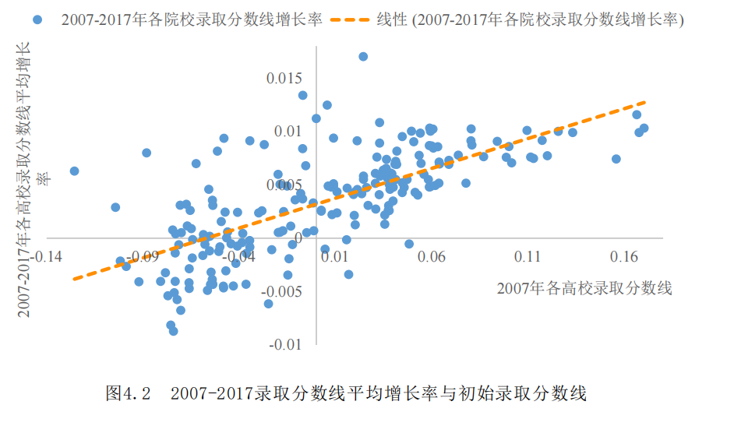
Introduction: Unbalanced College Expansion and Educational Involution
The widening gap in college admission cutoff scores, 2007-2017
Cutoff Growth Rate, 2007-2017
Cutoff in year 2007
来源：李思源（2019） Source: Li(2019)

Slide 5
Introduction: Unbalanced College Expansion and Educational Involution
Fierce competition for admission to high-quality colleges –“educational involution/anxiety” - has become a pressing social concern in China.
The average daily study time of high school students increased from 6.3 to 9.6 hours during 2008-2018 (NTUS)
Family education expenditure increased from 7.5% to 9.5% as the proportion of all cash expenditure during 2013-2023 (China Household Survey Yearbook), with current level much higher than the world average (Wei, 2023)
The unprecedent growth of the extra-curriculum training business, with new firm registrations and total investment more than tripled during 2014-2019, and total sales increasing more than 40%.
Serious and deteriorating mental health problem of high school students (Hou & Chen, 2021).

Slide 6
Introduction: Research Question
Our research questions:
How does an exam-centric college admissions system affect students' pre-college human capital investment?
How can we measure the possibly excess effort (or overinvestment in human capital) and associated welfare loss?
What policies from supply-side can reduce excess human capital investment and associated welfare loss?
Our key insights:
College admission is a tournament (or contest), in addition to a matching or resource allocation.
The incentive for pre-college human capital investment works through two channels: Productive channel & Competitive channel.
Not only the aggerate quantity and quality of colleges matters for pre-college HC investment, but also their quantity-quality composition.

Slide 7
Introduction: Preview of the Model
In our theoretical model:
Students are endowed with unobservable heterogeneous abilities and make (costly) effort to invest in pre-college human capital and strive for desirable college entrance exam (Gaokao) score.
Colleges, varying in their qualities, admit students according to their exam scores up to their quotas.
Wages after college graduation are jointly determined by student pre-college human capital level and the college quality.
We solve for a competitive equilibrium in which students take the admission cutoff scores as given. The equilibrium is achieved under cutoff scores equating the quota of each college (i.e., supply) and the (expected) number of students who make efforts to meet its cutoff (i.e., demand).

Slide 8
Introduction: Preview of the Results
We calibrate our model by estimating key parameters in Cobb-Douglas-formed pre-college human capital production function and wage determination equation, by using data from China’s college admissions.
Results (current system):
High-school students spend 2.3 more hours per day in study compared with under the first best scenario (i.e., 5.9 hours).
The efficiency loss, measured by the reduction of student surplus from the first-best, is equivalent to 1.5% of the post-college wage level (1/4-1/5 of one-year education return).
The competitive channel dominates the productive channel at the margin.
There are large variations among students. Higher-ability students suffer much more.

Slide 9
Introduction: Preview of the Results
Results (counterfactual analysis):
We explore the possibility of changing the quality-quantity composition of colleges in China’s college market to alleviate the excess efforts and associated efficiency loss.
Restricted to “resource neutral” policies (i.e., policies not changing the total college quality & quantity in the market), both reducing the quality-gap between colleges and expanding the high-quality college quotas can reduce excess efforts by up to 0.5 hours, deadweight loss up to 0.5 percentage point of wage level, and reduce competitive ratio by up to 13 percentage point.

Slide 10
Literature
Literature often find ambiguous effects of college admission policy on student efforts and academic performance.
Affirmative action
Non-structural (reduced) form: Caldwell, 2010; Antonovics and Backes, 2014; Akhtari et al., 2020; Cotton et al., 2022
Structural Form: Bodoh-Creed & Hickman 2017 (BH); Grau, 2018
"Top 10% Plan"
Reduced form: Cortes et al., 2011; Leeds et al., 2017
China’s college admissions
Reduced form: Xing, 2013, Luo et al., 2016, Xue, 2022

Slide 11
Other Related Literature
Stratification in higher education (mostly studied in the U.S.)
Sallee et al. (2008), Bound, Hershibein and Long (2009), Hoxby (2009)
Matching with efforts
Moldovanu and Sela (2001); Bodoh-Creed & Hickman (2018); Hafalir et al. (2018)
Matching in large markets
Azevedo and Leshno (2016): cutoff scores as “market prices” and students as “price takers”.

Slide 12
The Model
Part 2

Slide 13
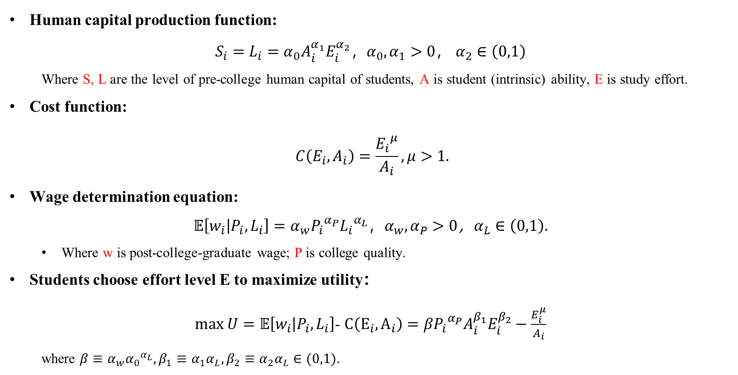
The Model: Students
Human capital production function:
$S_{i}=L_{i}=α_{0}A_{i}^{α_{1}}E_{i}^{α_{2}}，α_{0},α_{1}>0$，$α_{2}∈\left(0,1\right)$
Where S, L are the level of pre-college human capital of students, A is student (intrinsic) ability, E is study effort.
Cost function:
$$C\left(E_{i},A_{i}\right)=\frac{{E_{i}}^{μ}}{A_{i}}, μ>1.$$
Wage determination equation:
${𝔼\left[w_{i} | P_{i},L_{i}\right]=α}_{w}{P_{i}}^{α_{P}}{L_{i}}^{α_{L}}，α_{w},α_{P}>0$，$α_{L}∈\left(0,1\right).$
Where w is post-college-graduate wage; P is college quality.
Students choose effort level E to maximize utility：
$max U=𝔼\left[w_{i} | P_{i},L_{i}\right]$-$C\left(E_{i},A_{i}\right)=β{P_{i}}^{α_{P}}A_{i}^{β_{1}}E_{i}^{β_{2}}−\frac{E_{i}^{μ}}{A_{i}}$
where $β≡α_{w}{α_{0}}^{α_{L}}, β_{1}≡α_{1}α_{L}, β_{2}≡α_{2}α_{L}∈(0,1)$.

Slide 14
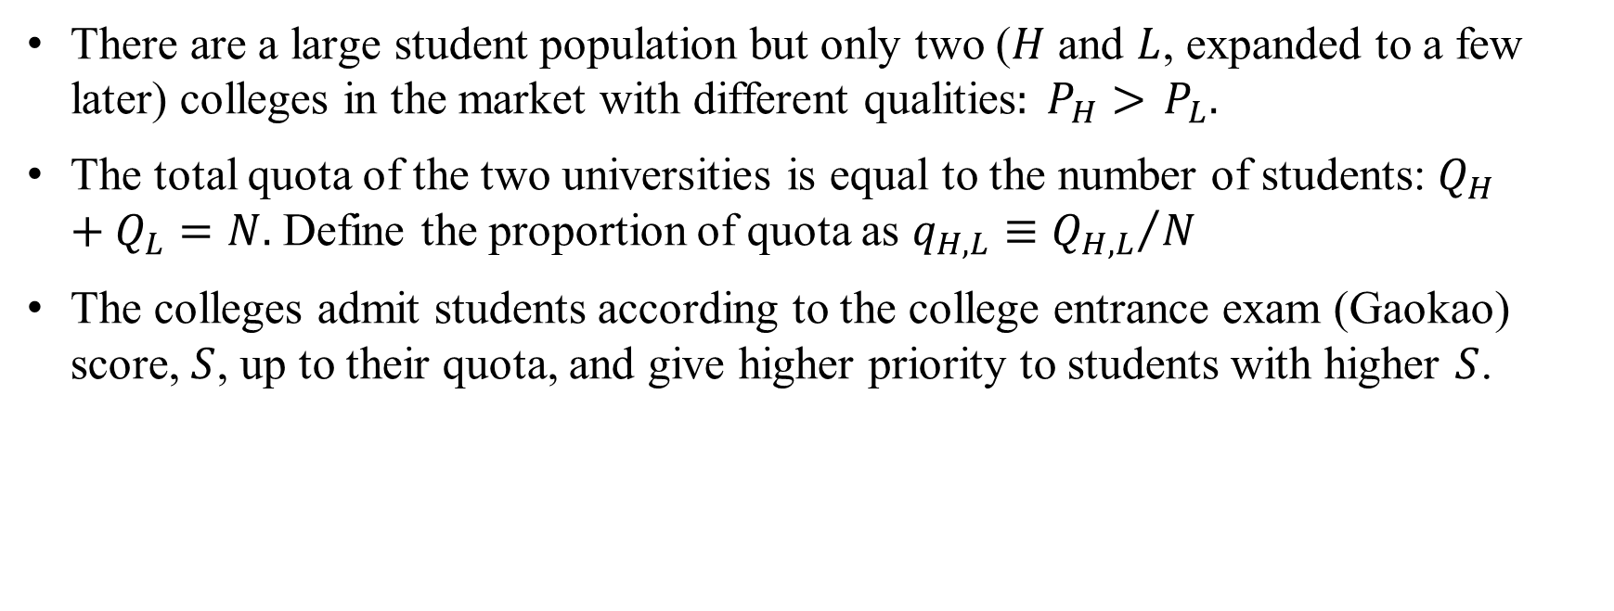
The Model: Colleges
There are a large student population but only two ($H$ and $L$, expanded to a few later) colleges in the market with different qualities$: P_{H}>$ $P_{L}.$
The total quota of the two universities is equal to the number of students: $Q_{H}+Q_{L}=N.$ Define the proportion of quota as $q_{H,L}≡{Q_{H,L}}/N$
The colleges admit students according to the college entrance exam (Gaokao) score, $S$, up to their quota, and give higher priority to students with higher $S$.

Slide 15
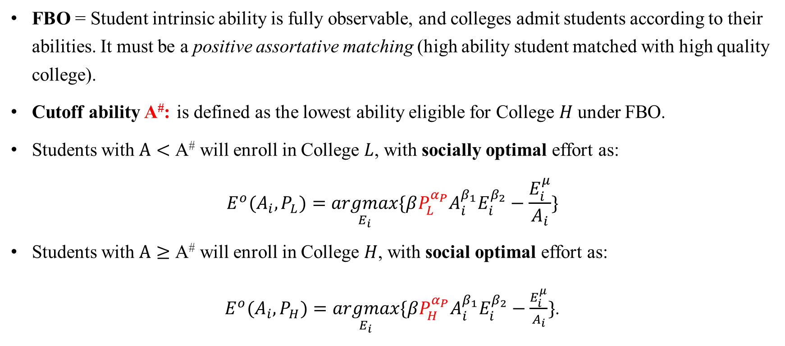
The Model: First-Best Outcome
FBO = Student intrinsic ability is fully observable, and colleges admit students according to their abilities. It must be a positive assortative matching (high ability student matched with high quality college).
Cutoff ability A#: is defined as the lowest ability eligible for College $H$ under FBO.
Students with $A<\text{A}\text{\#}$ will enroll in College $L$, with socially optimal effort as:
$$E^{o}(A_{i},P_{L})=\underset{E_{i}}{argmax}{\{βP_{L}^{α_{P}}A_{i}^{β_{1}}E_{i}^{β_{2}}−\frac{E_{i}^{μ}}{A_{i}}}\}$$
Students with $A≥\text{A}\text{\#}$ will enroll in College $H$, with social optimal effort as:
$E^{o}(A_{i},P_{H})=\underset{E_{i}}{argmax}{\{βP_{H}^{α_{P}}A_{i}^{β_{1}}E_{i}^{β_{2}}−\frac{E_{i}^{μ}}{A_{i}}}\}$.

Slide 16
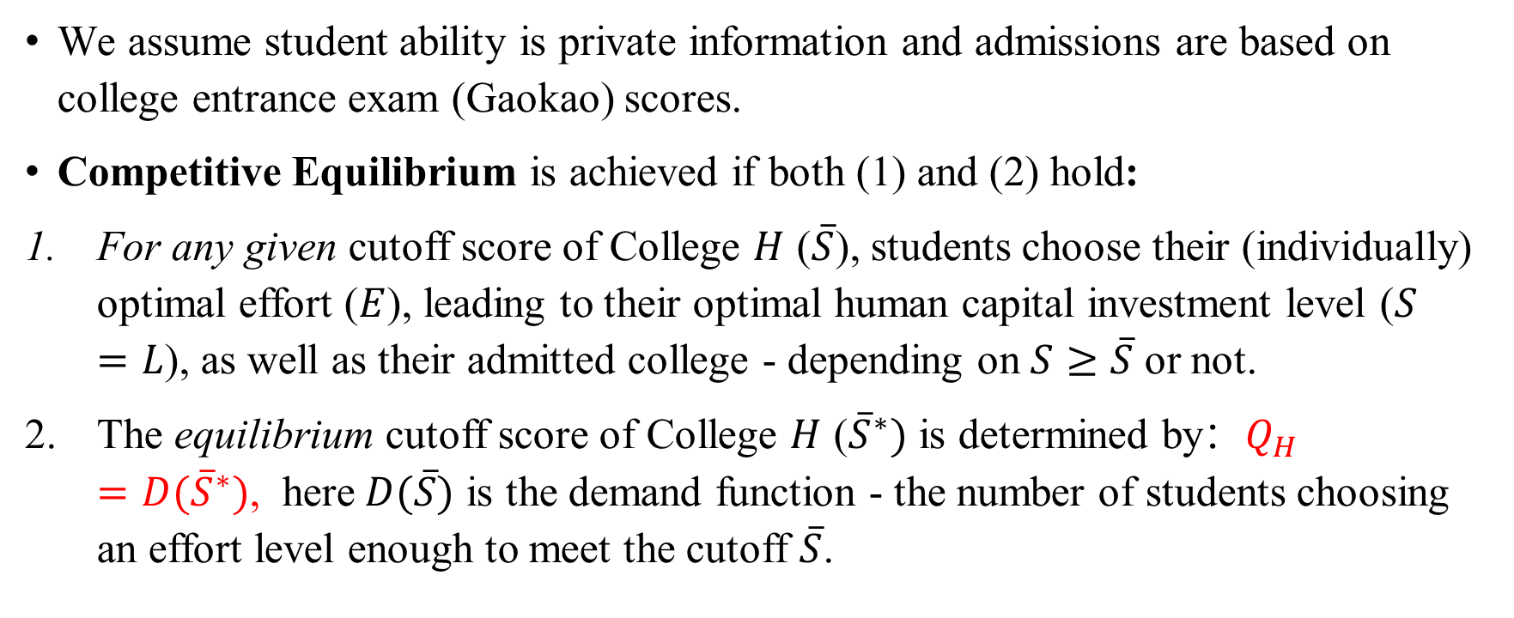
The Model: Competitive Equilibrium
We assume student ability is private information and admissions are based on college entrance exam (Gaokao) scores.
Competitive Equilibrium is achieved if both (1) and (2) hold:
For any given cutoff score of College $H$ ($\overline{S}$), students choose their (individually) optimal effort ($E$), leading to their optimal human capital investment level ($S=L$), as well as their admitted college - depending on $S≥\overline{S}$ or not.
The equilibrium cutoff score of College $H$ (${\overline{S}}^{∗})$ is determined by：$Q_{H}=D({\overline{S}}^{∗})$, here$D(\overline{S})$ is the demand function - the number of students choosing an effort level enough to meet the cutoff $\overline{S}$.

Slide 17
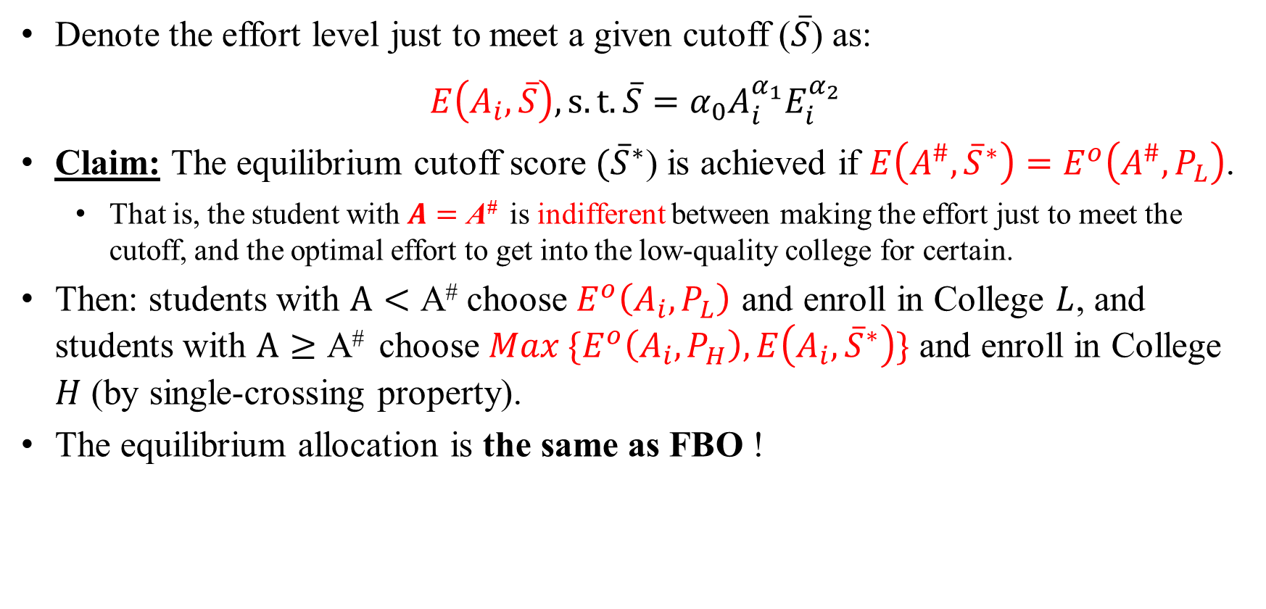
The Model: Competitive Equilibrium
Denote the effort level just to meet a given cutoff ($\overline{S}$) as:
$$E\left(A_{i},\overline{S}\right), s.t. \overline{S}=α_{0}A_{i}^{α_{1}}E_{i}^{α_{2}}$$
Claim: The equilibrium cutoff score $({\overline{S}}^{∗}$) is achieved if $E\left(A^{\#},{\overline{S}}^{∗}\right)=E^{o}\left(A^{\#},P_{L}\right)$.
That is, the student with $A=\text{A}\text{\#}$ is indifferent between making the effort just to meet the cutoff, and the optimal effort to get into the low-quality college for certain.
Then: students with $A<\text{A}\text{\#}$ choose $E^{o}\left(A_{i},P_{L}\right)$ and enroll in College $L$, and students with $A≥\text{A}\text{\#}$ choose $Max \{E^{o}\left(A_{i},P_{H}\right),E\left(A_{i},{\overline{S}}^{∗}\right)\}$ and enroll in College $H$ (by single-crossing property).
The equilibrium allocation is the same as FBO !

Slide 18
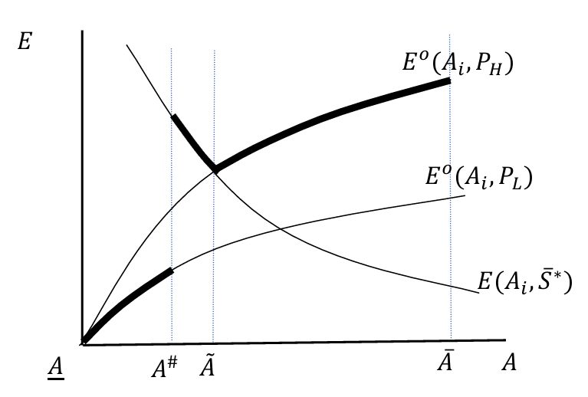
The Model: Competitive Equilibrium
Student with ability A# is indifferent between these two points.
Marginal students (i.e., students with excess efforts and welfare loss)
Figure 1 Student effort under competitive equilibrium

Slide 19
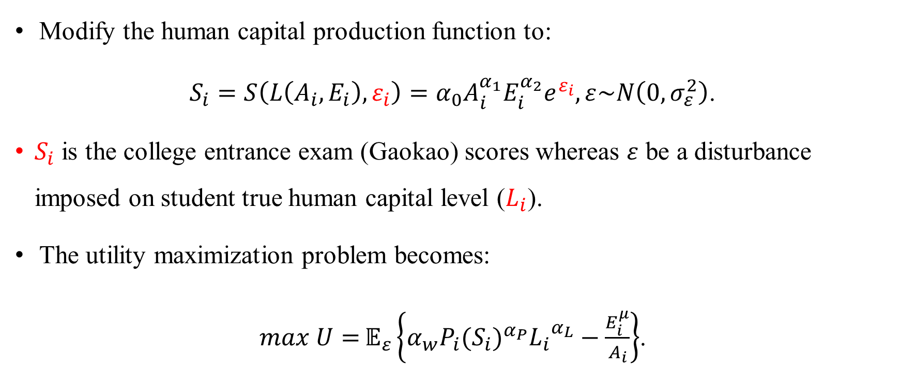
The Model: Competitive Equilibrium with Random Perturbations
Modify the human capital production function to:
$S_{i}=S\left(L\left(A_{i},E_{i}\right), ε_{i}\right)=α_{0}A_{i}^{α_{1}}E_{i}^{α_{2}}e^{ε_{i}}, ε\sim N\left(0,σ_{ε}^{2}\right)$.
$S_{i}$ is the college entrance exam (Gaokao) scores whereas $ε$ be a disturbance imposed on student true human capital level ($L_{i}$).
The utility maximization problem becomes:
$max U={𝔼_{ε}\left\{α_{w}{P_{i}(S_{i})}^{α_{P}}{L_{i}}^{α_{L}}−\frac{E_{i}^{μ}}{A_{i}}\right\}}$.

Slide 20
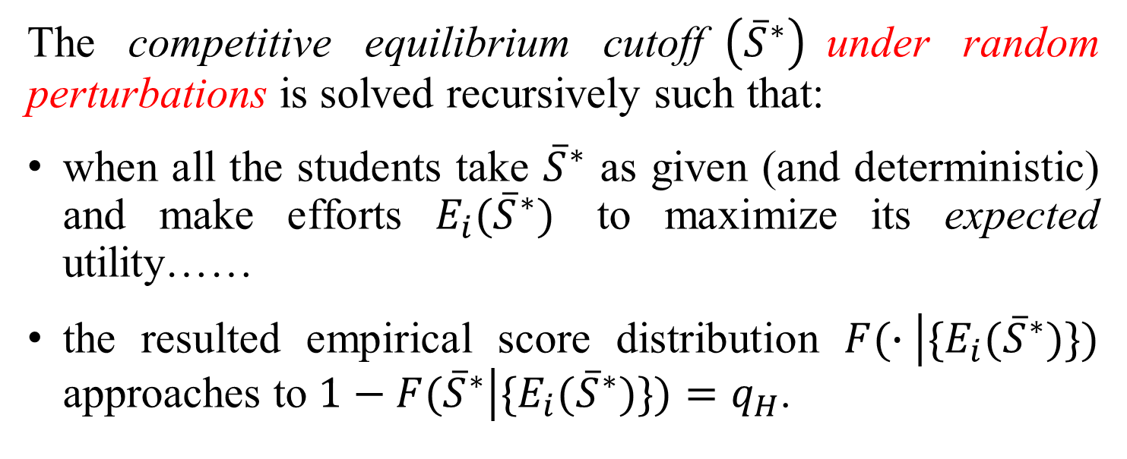
The Model: Competitive Equilibrium with Random Perturbation
The competitive equilibrium cutoff$\left({\overline{S}}^{∗}\right)$under random perturbations is solved recursively such that:
when all the students take ${\overline{S}}^{∗}$ as given (and deterministic) and make efforts $E_{i}({\overline{S}}^{∗})$ to maximize its expected utility……
the resulted empirical score distribution $F(∙\left|\{E_{i}({\overline{S}}^{∗})\})\right.$ approaches to $1−F({\overline{S}}^{∗}\left|\{E_{i}({\overline{S}}^{∗})\})\right.=q_{H}$.

Slide 21
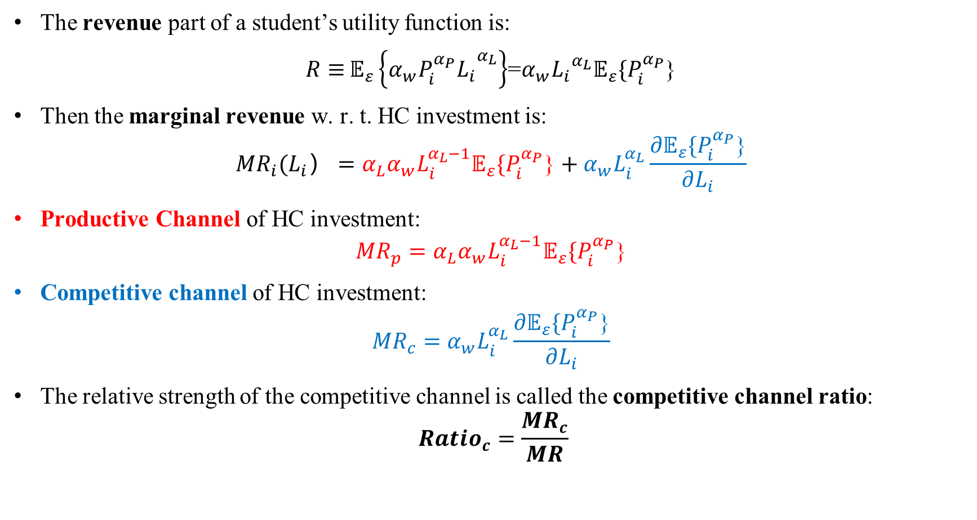
The Model: Productive Channel vs. Competitive Channel
The revenue part of a student’s utility function is:
$R≡{𝔼_{ε}\left\{{{α_{w}P_{i}^{α_{P}}L}_{i}}^{α_{L}}\right\}}$=$α_{w}{L_{i}}^{α_{L}}𝔼_{ε}\{P_{i}^{α_{P}}$}
Then the marginal revenue w. r. t. HC investment is:
$${MR}_{i}(L_{i}）=α_{L}α_{w}L_{i}^{α_{L}−1}𝔼_{ε}\{P_{i}^{α_{P}}\text{\}}+α_{w}L_{i}^{α_{L}}\frac{{∂𝔼}_{ε}\{P_{i}^{α_{P}}\text{\}}}{∂L_{i}}$$
Productive Channel of HC investment:
$${MR}_{p}=α_{L}α_{w}L_{i}^{α_{L}−1}𝔼_{ε}\{P_{i}^{α_{P}}\text{\}}$$
Competitive channel of HC investment:
$${MR}_{c}=α_{w}L_{i}^{α_{L}}\frac{{∂𝔼}_{ε}\{P_{i}^{α_{P}}\text{\}}}{∂L_{i}}$$
The relative strength of the competitive channel is called the competitive channel ratio:
$${Ratio}_{c}=\frac{{MR}_{c}}{MR}$$

Slide 22
Competitive Equilibrium: With Random Perturbation
(a) effort
(b) score(pre-college HC)
(c) utility
(d) Competitive channel ratio
Figure 3 Competitive equilibrium outcome (without/with random perturbation)
Graph Parameters

Slide 23
Empirical Calibration
Part 3

Slide 24
Data Source
China Family Panel Survey (CFPS, 2010-2020) (see Table A7)
25 provinces, 14,960 households, six rounds(biennial)
Including measures of students' abilities and human capital (by cognitive ability tests, CAT), daily study time, and socioeconomic status
In our sample: 1,200-4,700 high school students
China College Student Survey (CCSS 2013) (see Table A8)
Stratified random sampling, 65 colleges of all levels located in 23 provinces. Including measures of college entrance examination(Gaokao) scores, college GPA, post-graduation wages, and socioeconomic characteristics
In our sample: 5,929 college students from 30 residential provinces, taking Gaokao in 2009

Slide 25
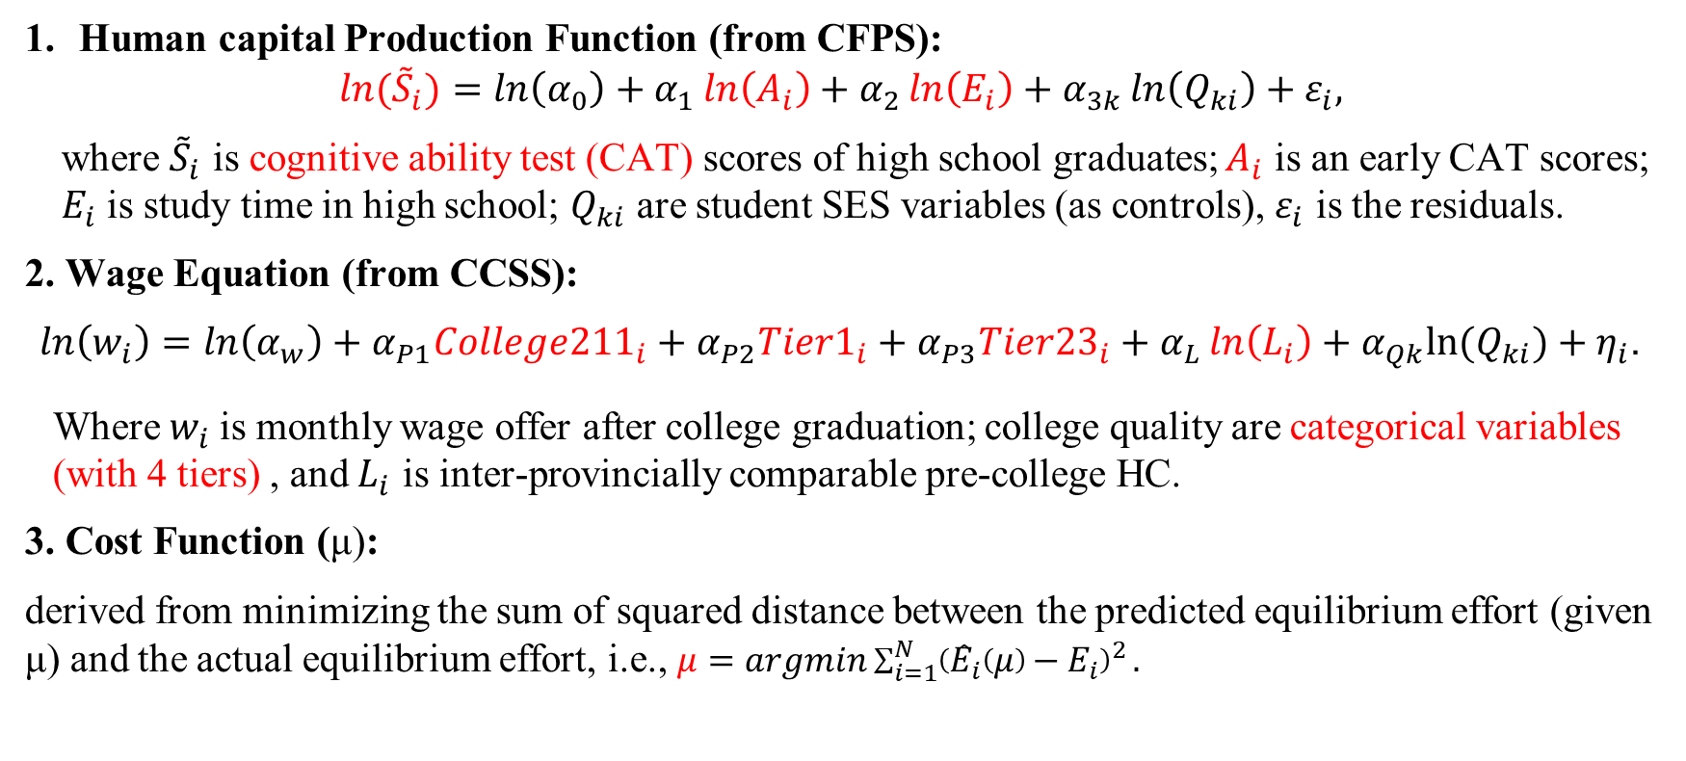
Model Estimation
Human capital Production Function (from CFPS):
$${ln⁡(\tilde{S}}_{i})=ln\left(α_{0}\right)+α_{1}\ln\left(A_{i}\right)+α_{2}\ln\left(E_{i}\right)+α_{3k}\ln\left(Q_{ki}\right)+ε_{i},$$
where ${\tilde{S}}_{i}$ is cognitive ability test (CAT) scores of high school graduates; $A_{i}$ is an early CAT scores; $E_{i}$ is study time in high school; $Q_{ki}$ are student SES variables (as controls), $ε_{i}$ is the residuals.
2. Wage Equation (from CCSS):
$\ln\left(w_{i}\right)=\ln\left(α_{w}\right)+α_{P1}{College211}_{i}+α_{P2}{Tier1}_{i}+α_{P3}{Tier23}_{i}+α_{L}\ln\left(L_{i}\right)+α_{Qk}{ln⁡(Q}_{ki})+η_{i}$.
Where $w_{i}$is monthly wage offer after college graduation; college quality are categorical variables (with 4 tiers) , and $L_{i}$ is inter-provincially comparable pre-college HC.
3. Cost Function (μ):
derived from minimizing the sum of squared distance between the predicted equilibrium effort (given μ) and the actual equilibrium effort, i.e., $μ=argmin\sum_{i=1}^{N}{{\left({\hat{E}}_{i}\left(μ\right)−E_{i}\right)}^{2}}.$

Slide 26
Model Estimation: Human Capital Production Function
Table 4 Estimating human capital production function (CFPS data)
 | Dependent variable: Ln(S)
 | All students | The last CAT test in middle school as ability(A) | Years between two CAT tests ≥ 6
 | (1) | (2) | (3) | (4)-IV | (5)
Ln(A) | 0.481*** | 0.559*** | 0.132* | 0.122 | 0.123*
 | (0.11) | (0.10) | (0.07) | (0.0798) | (0.06)
Ln(E) | 0.041* | 0.034* | 0.039*** | 0.0770 | 0.042***
 | (0.02) | (0.02) | (0.01) | (0.0848) | (0.01)
Ln(Finc) | 0.001 | 0.001 | -0.002 | -0.00156 | -0.005
 | (0.01) | (0.01) | (0.01) | (0.00660) | (0.01)
Ln(ParentEdu) | 0.035*** | 0.031*** | 0.023*** | 0.0242*** | 0.019***
 | (0.01) | (0.01) | (0.01) | (0.00670) | (0.01)
Ln(FamEduExp) |  |  |  |  | 0.008**
 |  |  |  |  | (0.00)
Male | -0.009* | -0.009* | 0.008 | 0.00661 | 0.014*
 | (0.01) | (0.01) | (0.01) | (0.00930) | (0.01)
Urban | 0.014 | 0.012 | 0.007 | 0.00248 | 0.012
 | (0.01) | (0.01) | (0.01) | (0.0135) | (0.01)
Constant | 2.121*** | 1.800*** | 3.692*** | 3.654*** | 3.726***
 | (0.44) | (0.39) | (0.31) | (0.224) | (0.26)
N | 2,468 | 2,468 | 1,306 | 1268 | 1,248
R² | 0.41 | 0.468 | 0.068 | 0.056 | 0.094

Slide 27
Model Estimation: Wage Determination Equation(CCSS)
Table 5 Estimating wage equation (CCSS data)
Dependent variable: Ln(w)
 | Unweighted Sample | Weighted Sample
 | (1) | (2)
College211 (vs Vocational) | 0.444*** | 0.468***
 | (0.035) | (0.040)
Tier1 | 0.279*** | 0.297***
 | (0.034) | (0.040)
Tier23 | 0.162*** | 0.180***
 | (0.031) | (0.038)
Ln(L) | 0.499*** | 0.452***
 | (0.058) | (0.090)
Ln(Finc) | 0.045*** | 0.046***
 | (0.008) | (0.010)
Ln(ParentEdu) | 0.027 | 0.026
 | (0.025) | (0.023)
Male | 0.098*** | 0.102***
 | (0.017) | (0.018)
Urban | -0.003 | -0.004
 | (0.019) | (0.021)
Constant | 5.353*** | 5.526***
 | (0.231) | (0.364)
N | 3,148 | 3,145
R² | 0.149 | 0.152

Slide 28
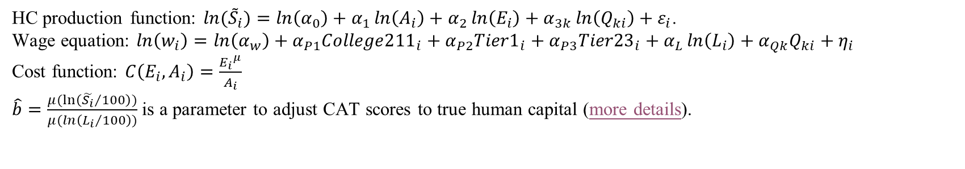
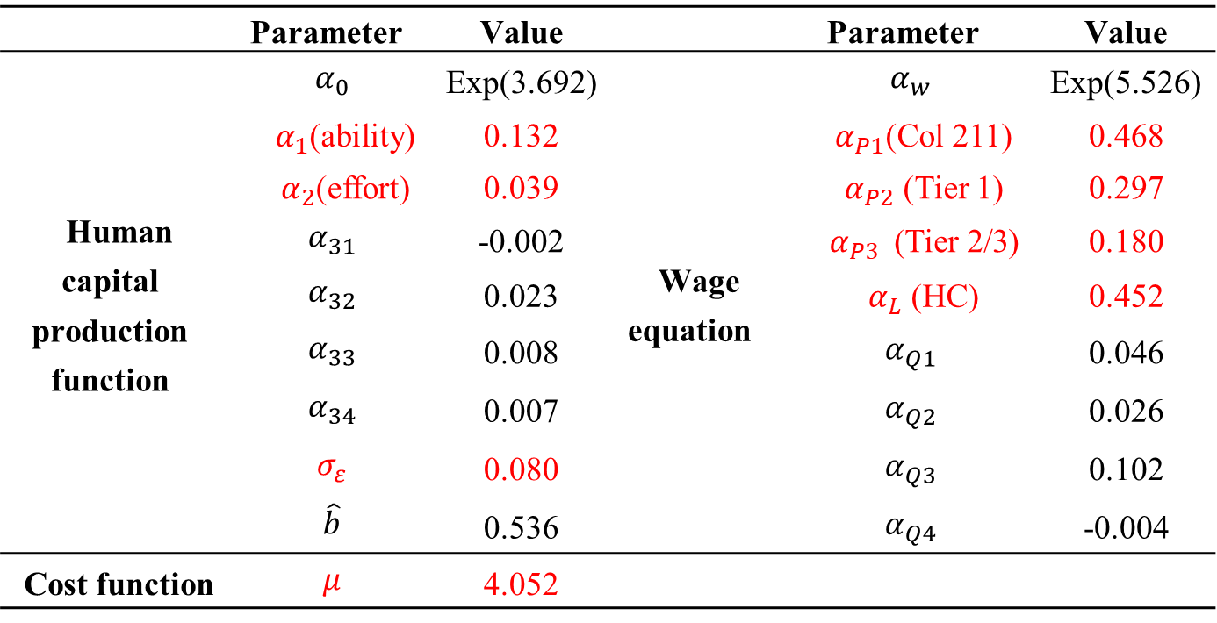
Model Estimation: Parameter Value
Table 6 Estimated parameter values
 | Parameter | Value |  | Parameter | Value
Human capital production function | $$α_{0}$$ | Exp(3.692) | Wage equation | $$α_{w}$$ | Exp(5.526)
 | $α_{1}$(ability) | 0.132 |  | $α_{P1}$(Col 211) | 0.468
 | $α_{2}$(effort) | 0.039 |  | $α_{P2}$ (Tier 1) | 0.297
 | $$α_{31}$$ | -0.002 |  | $α_{P3}$ (Tier 2/3) | 0.180
 | $$α_{32}$$ | 0.023 |  | $α_{L}$ (HC) | 0.452
 | $$α_{33}$$ | 0.008 |  | $$α_{Q1}$$ | 0.046
 | $$α_{34}$$ | 0.007 |  | $$α_{Q2}$$ | 0.026
 | $$σ_{ε}$$ | 0.080 |  | $$α_{Q3}$$ | 0.102
 | $$\hat{b}$$ | 0.536 |  | $$α_{Q4}$$ | -0.004
Cost function | $$μ$$ | 4.052
HC production function: ${ln⁡(\tilde{S}}_{i})=ln\left(α_{0}\right)+α_{1}\ln\left(A_{i}\right)+α_{2}\ln\left(E_{i}\right)+α_{3k}\ln\left(Q_{ki}\right)+ε_{i}$.
Wage equation: $\ln\left(w_{i}\right)=\ln\left(α_{w}\right)+α_{P1}{College211}_{i}+α_{P2}{Tier1}_{i}+α_{P3}{Tier23}_{i}+α_{L}\ln\left(L_{i}\right)+α_{Qk}Q_{ki}+η_{i}$
Cost function: $C\left(E_{i},A_{i}\right)=\frac{{E_{i}}^{μ}}{A_{i}}$
$\hat{b}=\frac{μ(\ln\left({\tilde{S_{i}}}/{100}\right))}{μ(ln\left({L_{i}}/{100}\right))}$ is a parameter to adjust CAT scores to true human capital (more details).

Slide 29
Simulation: Current System
(a) Effort
(b) HC
Figure 10 Simulated equilibrium under the current system
(red=eqm; black=FBO)
(c) Welfare
(d) Ratio_c

Slide 30
Simulation: The Benchmark (Current System)
Table 8 Simulated equilibrium under counterfactual policies
Counterfactual policy |  | Average effort (hours/day) | Average human capital (0-100) | Average utility (RMB/ month) | First best average utility (RMB/ month | Dead-weight loss (%) | Competitive channel ratio (0-1) | Cutoff scores (0-100)
 |  | (1) | (2) | (3) | (4) | (5) | (6) | (7)
First best and Benchmark | (0) first best (of benchmark) | 5.94 | 64.61 | 2351 | 2351 | 0 | 0 | 71.31, 67.10, 63.17
 | Benchmark | 8.23 | 66.59 | 2315 | 2351 | 1.53 | 0.564 | 78.39, 70.58, 63.72
Reduce Quality gap | (2) eliminate quality gap between tier 1&2 colleges | 8.11 | 66.52 | 2316 | 2348 | 1.35 | 0.543 | [78.12], 70.48, 63.70
 | (3) eliminate quality gap between tier 2&3 colleges | 8.00 | 66.46 | 2318 | 2344 | 1.12 | 0.524 | 78.15, [70.38], 63.61
 | (4) eliminate quality gap between tier 3&4 colleges | 7.74 | 66.27 | 2314 | 2339 | 1.07 | 0.428 | 78.37, 70.37, [63.26]
Increase quota of high-quality colleges | (5) increase quota of tier 1 college by 10% | 8.18 | 66.56 | 2315 | 2348 | 1.41 | 0.557 | 77.96, 70.44, 63.61
 | (6) increase quota of tier 1&2 colleges by 10% | 8.07 | 66.49 | 2313 | 2342 | 1.26 | 0.538 | 77.87, 69.89, 63.10
 | (7) increase quota of tier 1-3 colleges by 10% | 8.02 | 66.47 | 2311 | 2339 | 1.21 | 0.524 | 77.86, 69.86, 62.28
Add one median-quality college | (8) add one college between tier 1&2 colleges | 8.22 | 66.58 | 2315 | 2350 | 1.48 | 0.575 | 79.73, [74.55], 70.57, 63.71
 | (9) add one college between tier 2&3 colleges | 8.21 | 66.58 | 2315 | 2350 | 1.47 | 0.593 | 78.37, 72.30, [68.19], 63.71
 | (10) add one college between tier 3&4 colleges | 8.20 | 66.57 | 2314 | 2348 | 1.46 | 0.594 | 78.39, 70.56, 65.98, [61.51]
Change number of students | (11) reduce the total number of students by 10% | 8.21 | 66.55 | 2359 | 2394 | 1.47 | 0.554 | 77.93, 69.87, 62.19
 | (12) increase the total number of students by 10% | 8.23 | 66.59 | 2282 | 2318 | 1.56 | 0.574 | 78.73, 71.11, 64.82

Slide 31
Simulation: The Benchmark (Current System)
Equilibrium efforts (8.2hrs/day) are much higher than the first best efforts (5.9hrs/day), and the competitive channel dominates the productive channel (0.56).
The deadweight loss equals to 1.5% reduction of wage level, one fourth to fifth of the return to one-year schooling (5-12%).
There are also large variations of deadweight loss among students (std=9%), and high-ability students suffer more. (see Table A14)
The results are largely robust to several alternative specifications (more details.)

Slide 32
Counterfactual Analysis
Part 4

Slide 33
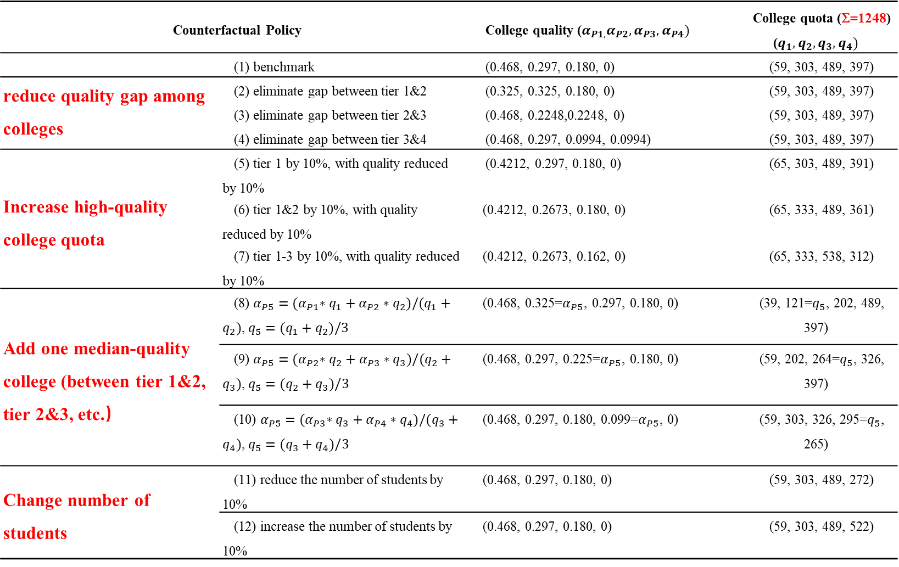
Policy Design
Table 7 Counterfactual Policies
Counterfactual Policy |  | College quality ($α_{P1,}α_{P2},α_{P3},α_{P4})$ | College quota (Σ=1248) ($q_{1},q_{2},q_{3},q_{4})$
 | (1) benchmark | (0.468, 0.297, 0.180, 0) | (59, 303, 489, 397)
reduce quality gap among colleges | (2) eliminate gap between tier 1&2 | (0.325, 0.325, 0.180, 0) | (59, 303, 489, 397)
 | (3) eliminate gap between tier 2&3 | (0.468, 0.2248,0.2248, 0) | (59, 303, 489, 397)
 | (4) eliminate gap between tier 3&4 | (0.468, 0.297, 0.0994, 0.0994) | (59, 303, 489, 397)
Increase high-quality college quota | (5) tier 1 by 10%, with quality reduced by 10% | (0.4212, 0.297, 0.180, 0) | (65, 303, 489, 391)
 | (6) tier 1&2 by 10%, with quality reduced by 10% | (0.4212, 0.2673, 0.180, 0) | (65, 333, 489, 361)
 | (7) tier 1-3 by 10%, with quality reduced by 10% | (0.4212, 0.2673, 0.162, 0) | (65, 333, 538, 312)
Add one median-quality college (between tier 1&2, tier 2&3, etc.） | (8) $α_{P5}={(α}_{P1}∗q_{1}+α_{P2}∗q_{2})/(q_{1}+q_{2})$, $q_{5}=(q_{1}+q_{2})/3$ | (0.468, 0.325=$α_{P5}$, 0.297, 0.180, 0) | (39, 121=$q_{5}$, 202, 489, 397)
 | (9) $α_{P5}={(α}_{P2}∗q_{2}+α_{P3}∗q_{3})/(q_{2}+q_{3})$, $q_{5}=(q_{2}+q_{3})/3$ | (0.468, 0.297, 0.225=$α_{P5}$, 0.180, 0) | (59, 202, 264=$q_{5}$, 326, 397)
 | (10) $α_{P5}={(α}_{P3}∗q_{3}+α_{P4}∗q_{4})/(q_{3}+q_{4})$, $q_{5}=(q_{3}+q_{4})/3$ | (0.468, 0.297, 0.180, 0.099=$α_{P5}$, 0) | (59, 303, 326, 295=$q_{5}$, 265)
Change number of students | (11) reduce the number of students by 10% | (0.468, 0.297, 0.180, 0) | (59, 303, 489, 272)
 | (12) increase the number of students by 10% | (0.468, 0.297, 0.180, 0) | (59, 303, 489, 522)
All the designs (except (11)-(12)) keep constant the total college quality in market.

Slide 34
Simulation: Counterfactual Policies
Table 8 Simulated equilibrium under counterfactual policies
Counterfactual policy |  | Average effort (hours/day) | Average human capital (0-100) | Average utility (RMB/ month) | First best average utility (RMB/ month | Dead-weight loss (%) | Competitive channel ratio (0-1) | Cutoff scores (0-100)
 |  | (1) | (2) | (3) | (4) | (5) | (6) | (7)
First best and Benchmark | (0) first best (of benchmark) | 5.94 | 64.61 | 2351 | 2351 | 0 | 0 | 71.31, 67.10, 63.17
 | (1) benchmark | 8.23 | 66.59 | 2315 | 2351 | 1.53 | 0.564 | 78.39, 70.58, 63.72
Reduce Quality gap | (2) eliminate quality gap between tier 1&2 colleges | 8.11 | 66.52 | 2316 | 2348 | 1.35 | 0.543 | [78.12], 70.48, 63.70
 | (3) eliminate quality gap between tier 2&3 colleges | 8.00 | 66.46 | 2318 | 2344 | 1.12 | 0.524 | 78.15, [70.38], 63.61
 | (4) eliminate quality gap between tier 3&4 colleges | 7.74 | 66.27 | 2314 | 2339 | 1.07 | 0.428 | 78.37, 70.37, [63.26]
Increase quota of high-quality colleges | (5) increase quota of tier 1 college by 10% | 8.18 | 66.56 | 2315 | 2348 | 1.41 | 0.557 | 77.96, 70.44, 63.61
 | (6) increase quota of tier 1&2 colleges by 10% | 8.07 | 66.49 | 2313 | 2342 | 1.26 | 0.538 | 77.87, 69.89, 63.10
 | (7) increase quota of tier 1-3 colleges by 10% | 8.02 | 66.47 | 2311 | 2339 | 1.21 | 0.524 | 77.86, 69.86, 62.28
Add one median-quality college | (8) add one college between tier 1&2 colleges | 8.22 | 66.58 | 2315 | 2350 | 1.48 | 0.575 | 79.73, [74.55], 70.57, 63.71
 | (9) add one college between tier 2&3 colleges | 8.21 | 66.58 | 2315 | 2350 | 1.47 | 0.593 | 78.37, 72.30, [68.19], 63.71
 | (10) add one college between tier 3&4 colleges | 8.20 | 66.57 | 2314 | 2348 | 1.46 | 0.594 | 78.39, 70.56, 65.98, [61.51]
Change number of students | (11) reduce the total number of students by 10% | 8.21 | 66.55 | 2359 | 2394 | 1.47 | 0.554 | 77.93, 69.87, 62.19
 | (12) increase the total number of students by 10% | 8.23 | 66.59 | 2282 | 2318 | 1.56 | 0.574 | 78.73, 71.11, 64.82

Slide 35
Simulation: Counterfactual Policies
Figure A2 Competitive channel vs. productive channel under counterfactual policies
(a) benchmark
(b) eliminate quality gap
between grp 3&4
(c) increase quota of grp1-3 by 10%
(d) add one median-quality college
(e) reduce the number
of students by 10%

Slide 36
Counterfactual Analysis: Simulated Results
Policies have positive effects on alleviating excessive efforts and reducing deadweight loss, despite of:
“constant total college quality/quantity” design
Ambiguous (offsetting) effects of some policies
Reducing quality-gap between low-quality colleges and expanding college quota of all colleges except the lowest-quality group seem to be more effective in alleviating excess efforts and welfare loss.
We also compare counterfactual policies under (hypothetical) equilibrium without perturbations. The policy effect in general is larger (more details).

Slide 37
Conclusion
Part 5

Slide 38
Conclusion
Excessive effort and welfare loss are sizable in the college admissions competition
Students tend to generate efforts larger than optimal level and suffer from welfare loss.
The competitive channel dominates the productive channel.
There can also be large distributive effects among students; those with abilities near the cutoffs of colleges with large quality-gap suffer more.
Supply side policies by changing quality-quantity composition in the college market can alleviate the excess effort and deadweight loss
Narrowing the gap in college quality and expanding the quota of higher-quality ones can reduce excessive efforts and reduce deadweight loss, especially at the low end of college market.

Slide 39
Future Research Questions
Multidimensional efforts?
Other Policies:
Exam reform: Freely choosing subjects; (hypothetical) restrictions on repetitive college entrance exam taking
Affirmative policies (“strong-foundation” plan, “self-strengthening” plan...... )
Outside option: high school tracking system; oversea higher education market

Slide 40
Thank You!
College Admission Policies and Pre-College Human Capital Investment: Evidence from China
by Chenglei Diao, Chenyuan Liu, and Xiaohan Zhong
Contact the presenter: zhongxh@sem.tsinghua.edu.cn
Man may be either broken in, trained, and mechanically taught, or he may be really enlightened.
-Immanuel Kant

Slide 41
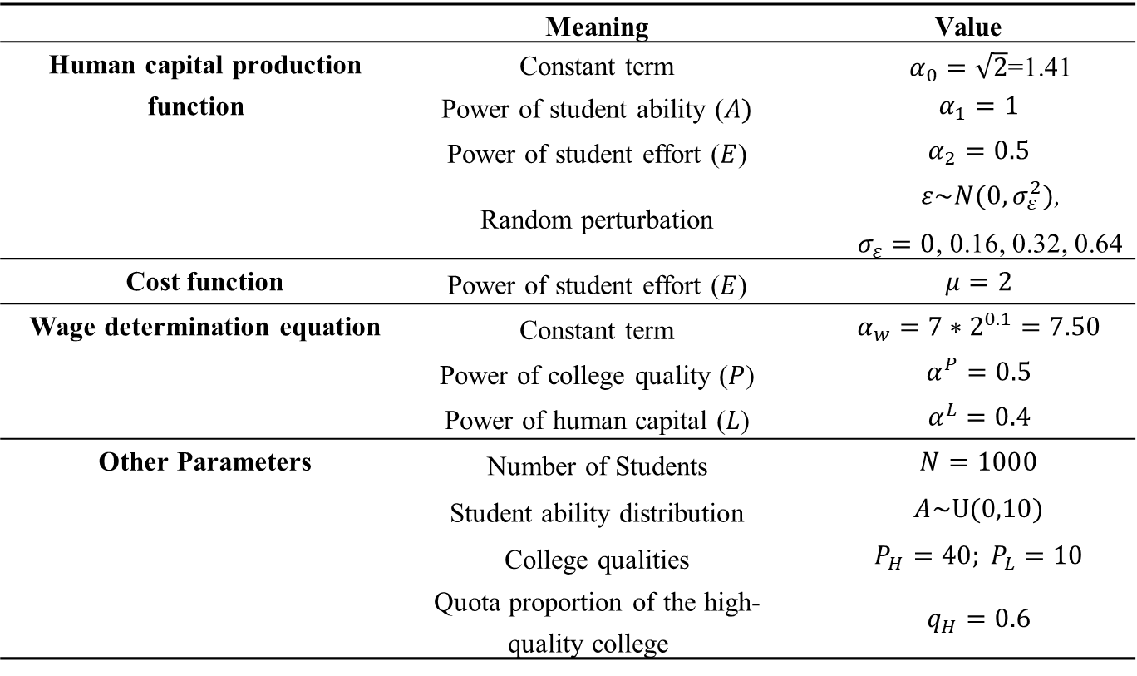
Competitive Equilibrium: Numerical Example
Table 1 Parameter setting in numerical simulation (benchmark)
 | Meaning | Value
Human capital production function | Constant term | $α_{0}=\sqrt{2}$=1.41
 | Power of student ability ($A)$ | $$α_{1}=1$$
 | Power of student effort ($E$) | $$α_{2}=0.5$$
 | Random perturbation | $ε\sim N(0,σ_{ε}^{2})$, $σ_{ε}=0$, 0.16, 0.32, 0.64
Cost function | Power of student effort ($E$) | $$μ=2$$
Wage determination equation | Constant term | $$α_{w}=7∗2^{0.1}=7.50$$
 | Power of college quality ($P$) | $$α^{P}=0.5$$
 | Power of human capital ($L$) | $$α^{L}=0.4$$
Other Parameters | Number of Students | $$N=1000$$
 | Student ability distribution | $$A\sim U(0,10)$$
 | College qualities | $$P_{H}=40; P_{L}=10$$
 | Quota proportion of the high-quality college | $$q_{H}=0.6$$
Back

Slide 42
Comparative Statics: Decreasing Quality Gap (by increasing low-quality college quality)
(a) effort
(b) HC
Figure 4 Comparative statics: Decreasing quality gap
P_{H}=40, P_{L}=10/20.
(c) welfare
(d) ratio_c

Slide 43
Comparative Statics: Decreasing High-Quality College Quota
(a) effort
(b) HC
Figure 5 Comparative Statics: Decreasing high-quality college quota
q_{H}=600/500.
(c) welfare
(d) ratio_c

Slide 44
Comparative Statics: Adding One Median-Quality College
(a) effort
(b) HC
Figure 6 Comparative statics: Adding one median-quality college
2/3 colleges
(c) welfare
(d) ratio_c

Slide 45
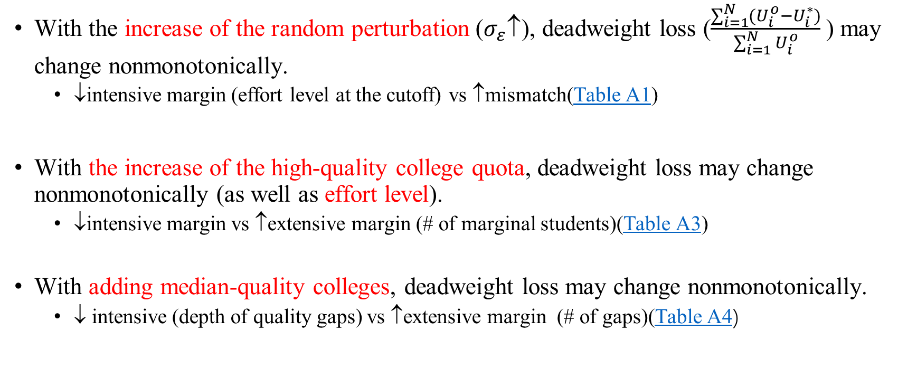
Comparative Statics: Some Nonmonotonic Effects (on Deadweight loss)
With the increase of the random perturbation ($σ_{ε}$↑), deadweight loss ($\frac{\sum_{i=1}^{N}{(U_{i}^{o}−U_{i}^{∗})}}{\sum_{i=1}^{N}{U_{i}^{o}}}$) may change nonmonotonically.
↓intensive margin (effort level at the cutoff) vs ↑mismatch(Table A1)
With the increase of the high-quality college quota, deadweight loss may change nonmonotonically (as well as effort level).
↓intensive margin vs ↑extensive margin (# of marginal students)(Table A3)
With adding median-quality colleges, deadweight loss may change nonmonotonically.
↓ intensive (depth of quality gaps) vs ↑extensive margin (# of gaps)(Table A4)
Back

Slide 46
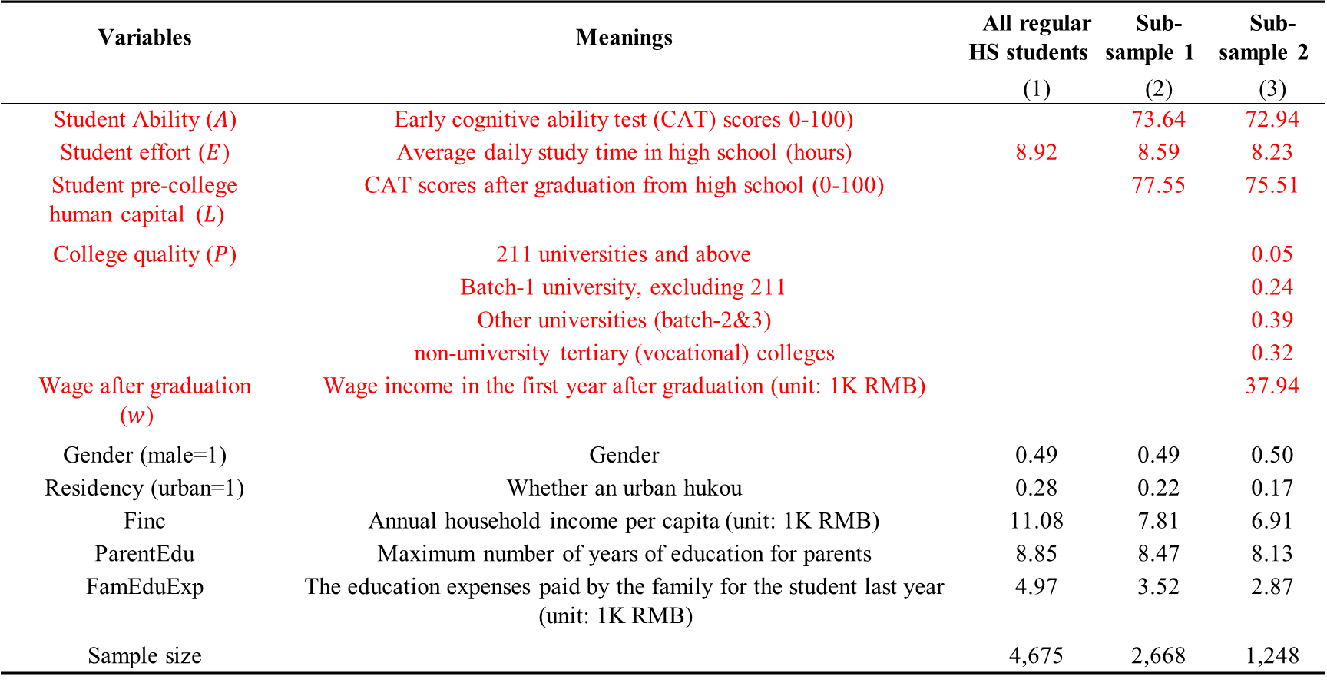
CFPS: Statistic Summary
Table A7 CFPS Variables: Statistic Summary
Variables | Meanings | All regular HS students | Sub-sample 1 | Sub-sample 2
 |  | (1) | (2) | (3)
Student Ability ($A$) | Early cognitive ability test (CAT) scores 0-100) |  | 73.64 | 72.94
Student effort ($E$) | Average daily study time in high school (hours) | 8.92 | 8.59 | 8.23
Student pre-college human capital ($L$) | CAT scores after graduation from high school (0-100) |  | 77.55 | 75.51
College quality ($P$) | 211 universities and above |  |  | 0.05
 | Batch-1 university, excluding 211 |  |  | 0.24
 | Other universities (batch-2&3) |  |  | 0.39
 | non-university tertiary (vocational) colleges |  |  | 0.32
Wage after graduation ($w$) | Wage income in the first year after graduation (unit: 1K RMB) |  |  | 37.94
Gender (male=1) | Gender | 0.49 | 0.49 | 0.50
Residency (urban=1) | Whether an urban hukou | 0.28 | 0.22 | 0.17
Finc | Annual household income per capita (unit: 1K RMB) | 11.08 | 7.81 | 6.91
ParentEdu | Maximum number of years of education for parents | 8.85 | 8.47 | 8.13
FamEduExp | The education expenses paid by the family for the student last year (unit: 1K RMB) | 4.97 | 3.52 | 2.87
Sample size |  | 4,675 | 2,668 | 1,248
Back

Slide 47
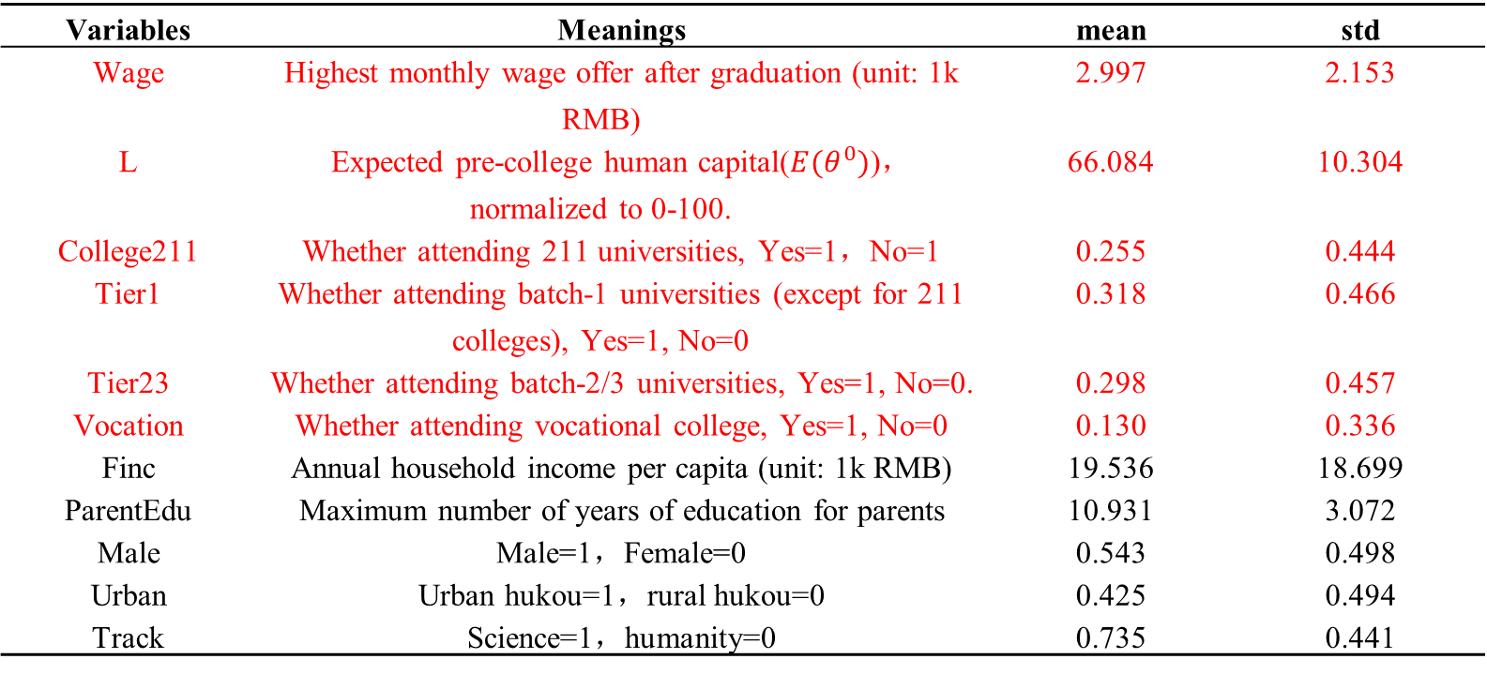
CCSS: Statistic Summary
Table A8 CCSS Variables: Statistic Summary
Variables | Meanings | mean | std
Wage | Highest monthly wage offer after graduation (unit: 1k RMB) | 2.997 | 2.153
L | Expected pre-college human capital($E(θ^{0})$)，normalized to 0-100. | 66.084 | 10.304
College211 | Whether attending 211 universities, Yes=1，No=1 | 0.255 | 0.444
Tier1 | Whether attending batch-1 universities (except for 211 colleges), Yes=1, No=0 | 0.318 | 0.466
Tier23 | Whether attending batch-2/3 universities, Yes=1, No=0. | 0.298 | 0.457
Vocation | Whether attending vocational college, Yes=1, No=0 | 0.130 | 0.336
Finc | Annual household income per capita (unit: 1k RMB) | 19.536 | 18.699
ParentEdu | Maximum number of years of education for parents | 10.931 | 3.072
Male | Male=1，Female=0 | 0.543 | 0.498
Urban | Urban hukou=1，rural hukou=0 | 0.425 | 0.494
Track | Science=1，humanity=0 | 0.735 | 0.441
Back

Slide 48
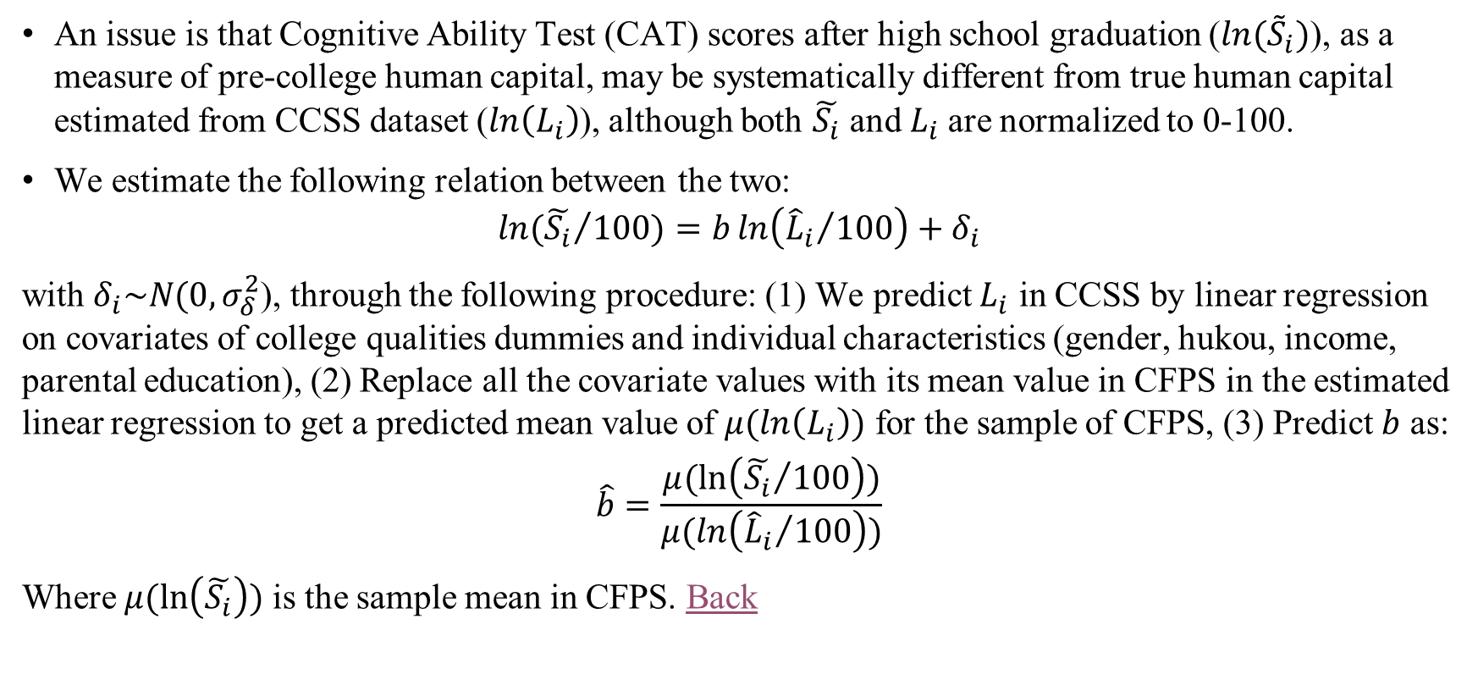
Model Estimation: Adjust CAT to HC
An issue is that Cognitive Ability Test (CAT) scores after high school graduation (${ln⁡(\tilde{S}}_{i})$), as a measure of pre-college human capital, may be systematically different from true human capital estimated from CCSS dataset ($\ln\left(L_{i}\right)$), although both $\tilde{S_{i}}$ and $L_{i}$are normalized to 0-100.
We estimate the following relation between the two:
$$ln⁡({\tilde{S_{i}}}/{100})=b\ln\left({{\hat{L}}_{i}}/{100}\right)+δ_{i}$$
with $δ_{i}\sim N(0, σ_{δ}^{2}$), through the following procedure: (1) We predict $L_{i}$ in CCSS by linear regression on covariates of college qualities dummies and individual characteristics (gender, hukou, income, parental education), (2) Replace all the covariate values with its mean value in CFPS in the estimated linear regression to get a predicted mean value of $μ(ln\left(L_{i}\right))$ for the sample of CFPS, (3) Predict $b$ as:
$$\hat{b}=\frac{μ(\ln\left({\tilde{S_{i}}}/{100}\right))}{μ(ln\left({{\hat{L}}_{i}}/{100}\right))}$$
Where $μ(\ln\left(\tilde{S_{i}}\right))$ is the sample mean in CFPS. Back

Slide 49
Simulation: The Benchmark (Current System)
Table A14 Distributive Effect under the Benchmark: OLS regression
 | Excess effort (%) | Deadweight loss (%) | Competitive channel ratio (%)
 | (1) | (2) | (3)
Ability | 0.406*** | 0.090** | 0.690***
 | (0.017) | (0.037) | (0.030)
Ln(Finc) | 0.332 | -0.862 | 0.240
 | (0.283) | (0.634) | (0.503)
Ln(ParentEdu) | 1.141*** | 0.086 | 4.072***
 | (0.341) | (0.765) | (0.606)
Urban | -1.626** | 0.138 | -3.075***
 | (0.643) | (1.442) | (1.143)
Male | -0.146 | -2.058** | 0.798
 | (0.447) | (1.001) | (0.793)
Dep. Var. Mean | 38.316 | -1.188 | 56.384
Std | 9.724 | 17.692 | 17.306
Min | 0.000 | -58.586 | 0.000
Max | 57.410 | 39.230 | 76.837
N | 1,248 | 1,248 | 1,248
R² | 0.347 | 0.010 | 0.350
Back

Slide 50
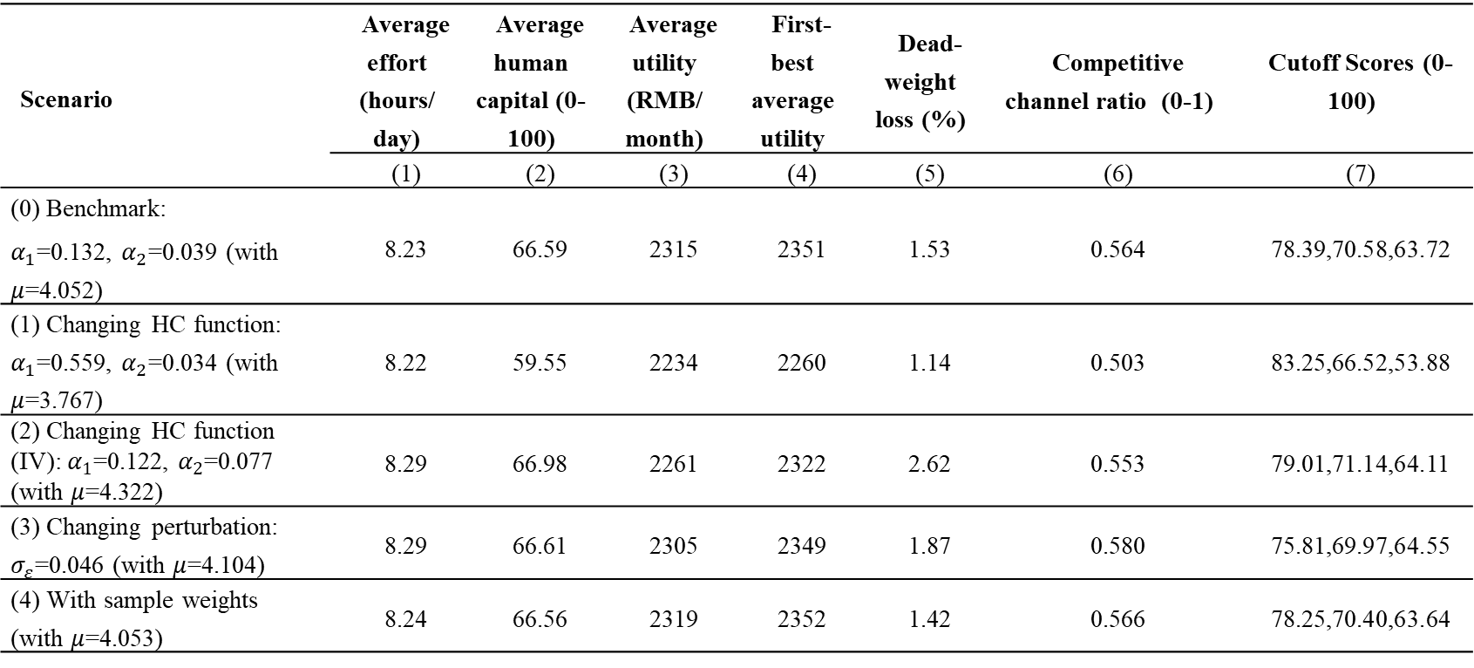
Robust Check on Benchmark
Table A15 Robust Check on Benchmark
Scenario | Average effort (hours/ day) | Average human capital (0-100) | Average utility (RMB/ month) | First-best average utility | Dead-weight loss (%) | Competitive channel ratio (0-1) | Cutoff Scores (0-100)
 | (1) | (2) | (3) | (4) | (5) | (6) | (7)
(0) Benchmark: $α_{1}$=0.132, $α_{2}$=0.039 (with $μ$=4.052) | 8.23 | 66.59 | 2315 | 2351 | 1.53 | 0.564 | 78.39,70.58,63.72
(1) Changing HC function: $α_{1}$=0.559, $α_{2}$=0.034 (with $μ$=3.767) | 8.22 | 59.55 | 2234 | 2260 | 1.14 | 0.503 | 83.25,66.52,53.88
(2) Changing HC function (IV): $α_{1}$=0.122, $α_{2}$=0.077 (with $μ$=4.322) | 8.29 | 66.98 | 2261 | 2322 | 2.62 | 0.553 | 79.01,71.14,64.11
(3) Changing perturbation: $σ_{ε}$=0.046 (with $μ$=4.104) | 8.29 | 66.61 | 2305 | 2349 | 1.87 | 0.580 | 75.81,69.97,64.55
(4) With sample weights (with $μ$=4.053) | 8.24 | 66.56 | 2319 | 2352 | 1.42 | 0.566 | 78.25,70.40,63.64
Back

Slide 51
Simulated Equilibrium without Perturbations
Table A16 Equilibrium and selected counterfactuals without random perturbations
Scenario | Average effort (hours/ day) | Average human capital (0-100) | Average utility (RMB/ month) | First-best average utility | Deadweight loss (%) | Cutoff Scores (0-100)
 | (1) | (2) | (3) | (4) | (5) | (6)
(1’) current system | 7.85 | 65.48 | 2239 | 2351 | 4.74% | 76.29, 70.80, 67.07
(4’) eliminate quality gap between tier 3&4 colleges | 7.21 | 64.60 | 2280 | 2339 | 2.52% | 75.80, 71.33, [63.22]
(7’) increase quota of tier 1-3 colleges by 10% | 7.93 | 65.79 | 2261 | 2339 | 3.35% | 75.96, 70.30, 66.00
(8’) add one college between tier 1&2 colleges | 8.18 | 65.98 | 2274 | 2350 | 3.23% | 76.13, [71.97], 70.80, 67.07
(11’) reduce the total number of students by 10% | 8.06 | 65.84 | 2302 | 2394 | 3.85% | 76.07, 70.35, 66.00
Back

